Slide 1

CAP477 PROGRAMMING IN JAVA
Unit-5

Slide 2

What do we need to know?
Unit 5
Exceptions and Assertions, I/O Fundamentals

Slide 3
Topics Covered….
handling exceptions in Java

Slide 4
Exception Handling
Exception is an abnormal condition means result out of expectation. Exception is an event that disturbs the normal flow of the program. Actually it is unexpected result which we do not think. Suppose we have defined array with size 5 but we are trying to access array of index 6. So, in this situation exception occurs.

Slide 5
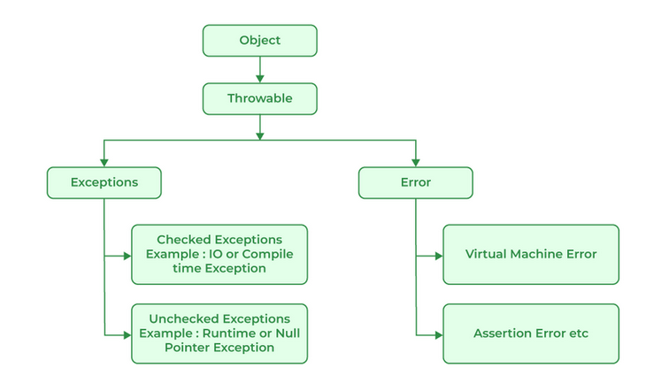
Exception Hierarchy

Slide 6
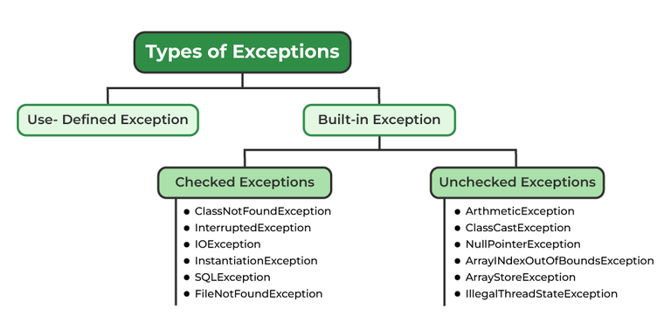

Slide 7
Built-in Exceptions
Checked Exception
Unchecked Exception

Slide 8
Built-in Exceptions
Checked Exceptions: Checked exceptions are called compile-time exceptions because these exceptions are checked at compile-time by the compiler.
Unchecked Exceptions:
The unchecked exceptions are just opposite to the checked exceptions. The compiler will not check these exceptions at compile time.

Slide 9
User-Defined Exceptions:
Sometimes, the built-in exceptions in Java are not able to describe a certain situation. In such cases, users can also create exceptions, which are called ‘user-defined Exceptions’.

Slide 10
Exception Handling where exceptions may occur
int a=50/0;//ArithmeticException
String s=null; System.out.println(s.length());//NullPointerException
String s="abc";
int i=Integer.parseInt(s);//NumberFormatException
int a[]=new int[5]; a[10]=50; //ArrayIndexOutOfBoundsException

Slide 11
Five keywords used in Exception handling:
try
catch
finally
throw
throws

Slide 12
Checked Exception Example
ClassNotFoundExceptionExample.java
public class ClassNotFoundExceptionExample {
public static void main(String[] args) {
try {
Class<?> clazz = Class.forName("com.example.NonExistentClass");
} catch (ClassNotFoundException e) {
System.out.println("Class not found: " + e.getMessage());
}
}
}

Slide 13
Types of Unchecked Exceptions
ArithmeticException
NullPointerException
ArrayIndexOutOfBoundsException
NumberFormatException
InputMismatchException
IllegalStateException

Slide 14
Example: ArithmeticException
public class JavaExceptionExample{
public static void main(String args[]){
try{
//code that may raise exception
int data=100/0;
}catch(ArithmeticException e){System.out.println(e);}
//rest code of the program
System.out.println("rest of the code...");
}
}

Slide 15
Methods to print the Exception information:
printStackTrace(): This method prints exception information
toString(): The toString() method prints exception information
getMessage():
The getMessage() method prints only the description of the exception.

Slide 16
finally block
The finally block is a block that is always executed. It is mainly used to perform some important tasks such as closing connection, stream etc.
Rule: For each try block there can be zero or more catch blocks, but only one finally block.

Slide 17
Multiple catch block:
Rule: At a time only one Exception is occured and at a time only one catch block is executed.
Rule: All catch blocks must be ordered from most specific to most general i.e. catch for ArithmeticException must come before catch for Exception .
Example: tryMultiCatchEx

Slide 18
Throw/throws keyword
If a method does not handle a checked exception, the method must declare it using the throws keyword. The throws keyword appears at the end of a method's signature.
The throw keyword is used to explictily throw an exception. We can throw either checked or uncheked exception. The throw keyword is mainly used to throw custom exception.
Throw –Example(throwExceptionEx.java)
Throws-Example(throwsExceptionEx.java)

Slide 19
import java.io.*;
public class className
{
public void deposit(double amount) throws IOException
{
// Method implementation
throw new MyException();
}
}

Slide 20
differences
throws Used with method signature while throw used inside method
1) You can declare multiple exception thrown by method in throws keyword by separating them in common e.g. throws IOException, ArrayIndexBoundException etc, while you can only throw one instance of exception using throw keyword e.g. throw new IOException("not able to open connection").
throw keyword can also be used to break a switch statement without using break

Slide 21
int number = 5;
switch(number){
case 1:
throw new RuntimeException("Exception number 1");
case 2:
throw new RuntimeException("Exception number 2");
}

Slide 22
Custom exception
class MyException extends Exception
{
}
Example:-CustomException(invalidInputException.java) and (invalidInputExceptionEx.java)
Exception methods:
printStackTrace():for displaying exception message with details
getMessage(): Only display exception name

